Slide 1
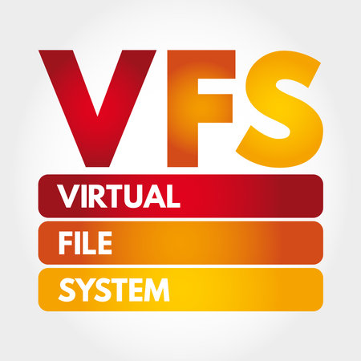
Customised Virtual File System
– Jitesh Anil Varade
Research Based Project

Slide 2
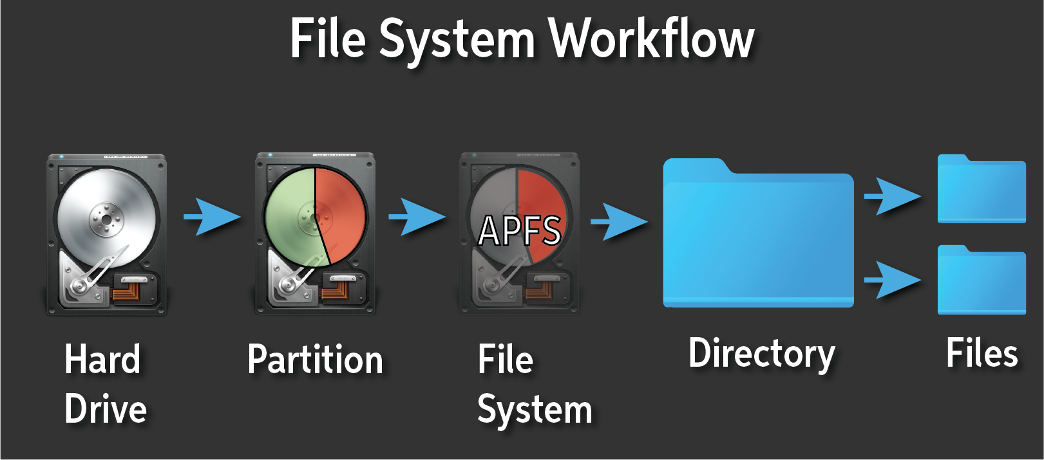
What is a file system?
A file system is method and data structure that an operating system uses to control how data is stored and retrieved on a storage device, such as hard drive, solid state drive(SSD), it provides a way for users to access and manage their files.

Slide 3
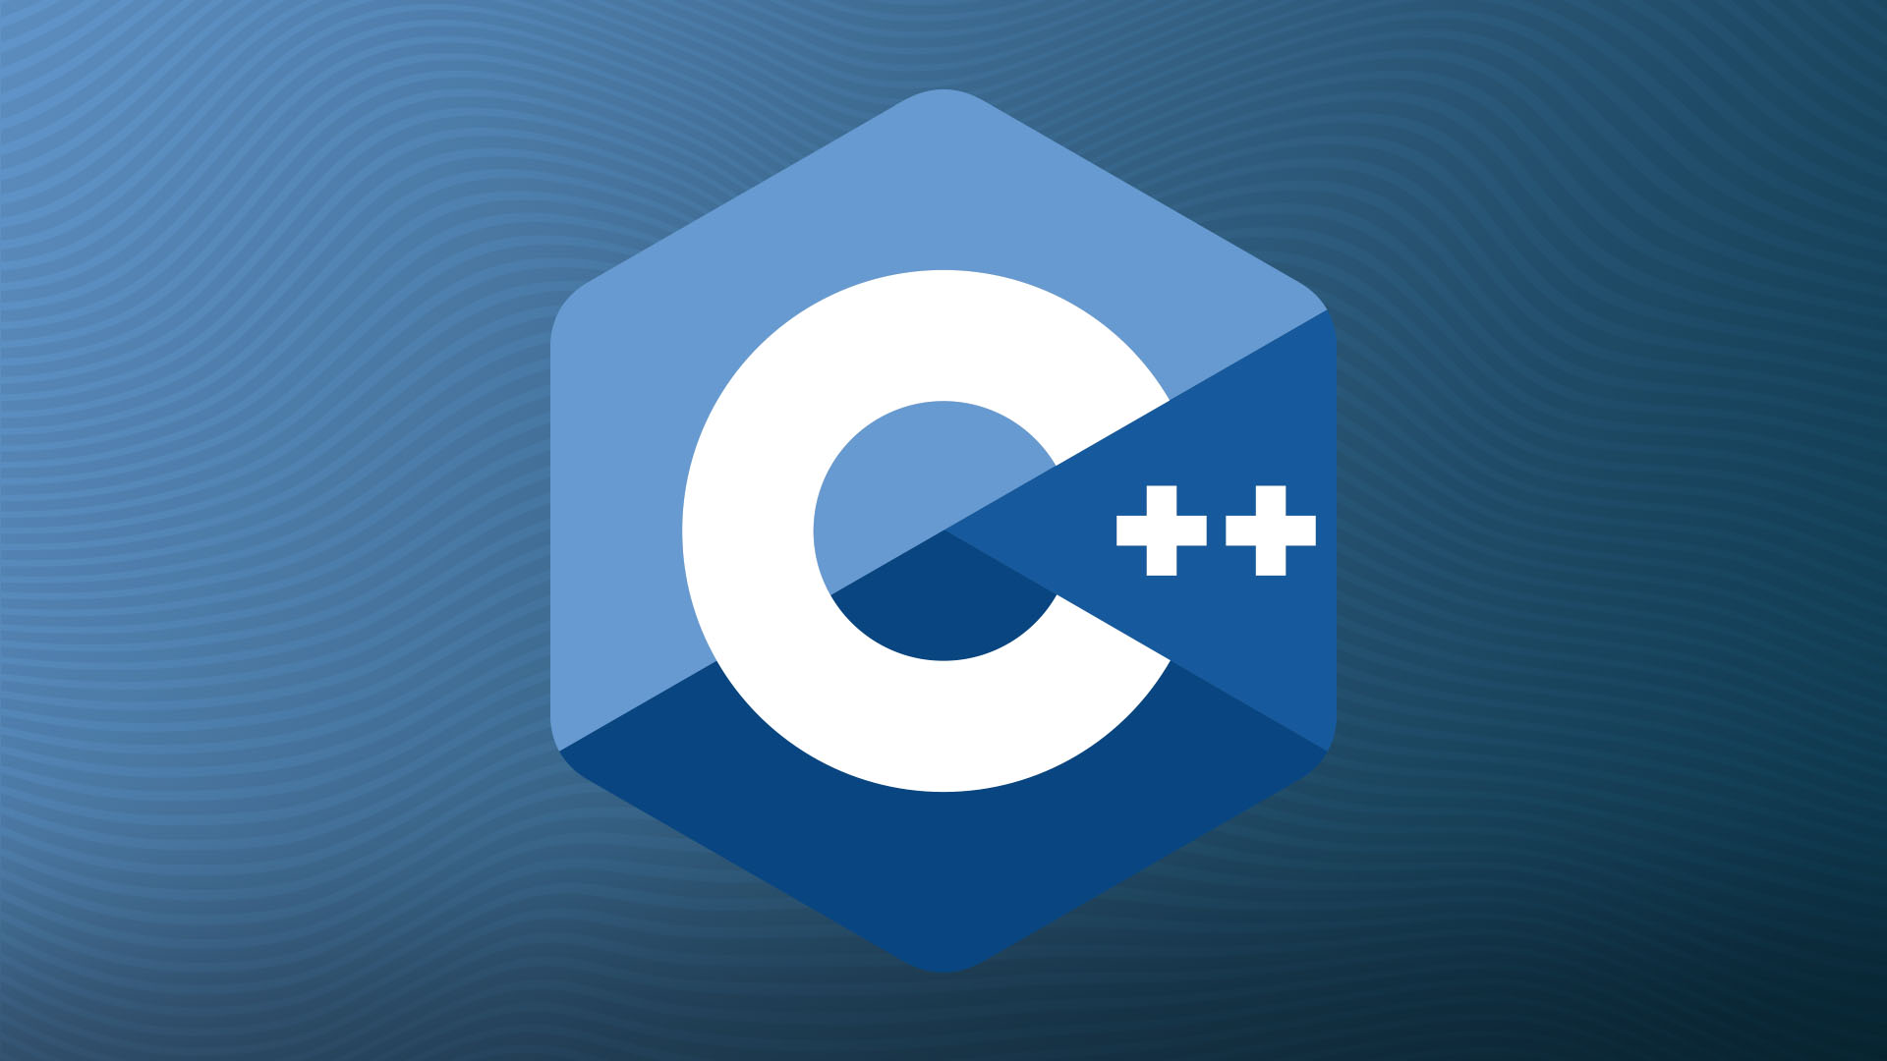
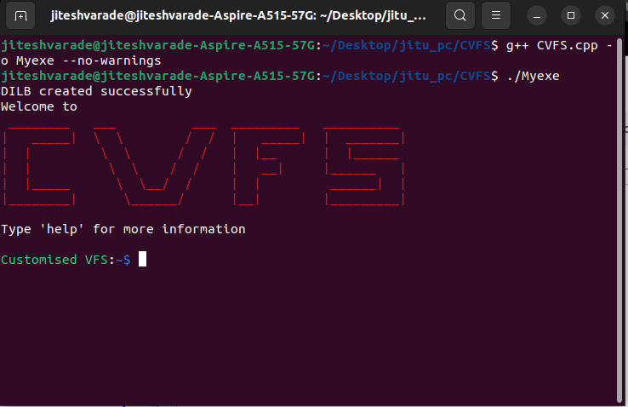
Technologies used :
System programming using C++
User Interface :
Command Line Interface

Slide 4
About Virtual File System :
In this project I have emulate all data structures which are used by operating system to manage File system oriented tasks.
As the name suggests it’s virtual because I have maintain all the records in Primary storage.
Data structures : Inode Table, File Table, UAREA, User File Descriptor Table, Super block, Disk Inode List Block, Data Block etc.
Necessary system calls : open, close, read, write, lseek, creat, rm, ls, stat, fstat etc.
By using this project we can get a overview of UFS (UNIX File Systems) on any platform.

Slide 5
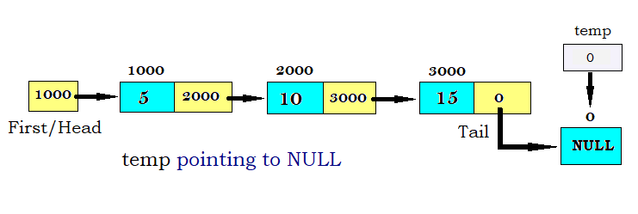
Hard drive
Actual Data
Inode
Code use to start the operating system
Information about the file system:
No of inodes,free inodes, used inodes
Hello world
apple,cherry,mango
bootblock
superblock
Disk Inode List table
Data block

Slide 6
Thank You!

